Slide 1
Chapter 12: Database Managers on z/OS
DB2 (and IMS)

Slide 2
What is a database?
A database provides for the storing and control of business information, independent from one or more applications.

Slide 3
Why use a database?
Reduce programming effort
Manage data more efficiently
Easy to separate confidential/sensitive info
Provide a greater level of security
Access & update simultaneously
Ensure consistency
Provide backup and recovery
Utilities to monitor and tune
Structure change does not impact existing developments

Slide 4
Databases on z/OS
Hierarchical databases, such as IMS
Relational database management system (RDBMS), such as DB2

Slide 5
A database comparison:
IMS:
  Data is relatively static
  Navigational : need to know the structure to get to the right data
DB2:
  Changeable info
  Change in structure : no impact on existing application
  Non-Navigational : no need to know the structure to get to the right data (just tablename and columnname(s))

Slide 6
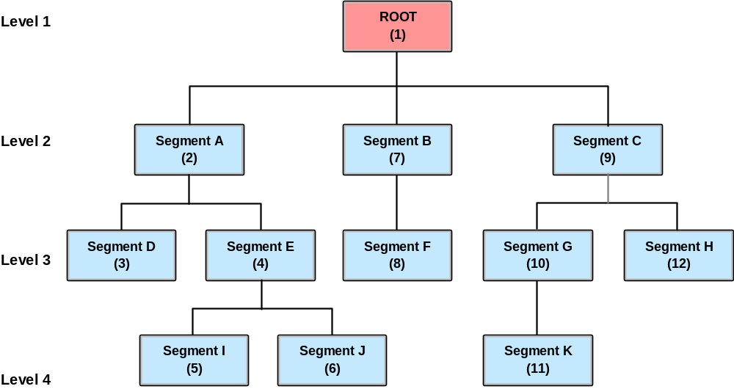
Hierarchical DB (IMS) : Relationships & sequence
Notes:
Hierarchical data structure describes the data of one database record.
Hierarchical data structure is the parent/child relationship between data segments.
The sequence of traversing the hierarchy is top to bottom, left to right, front to back (for twins).
A single IMS database is similar to a single DB2 table.
So an IMS application may have access to a large number of databases.

Slide 7
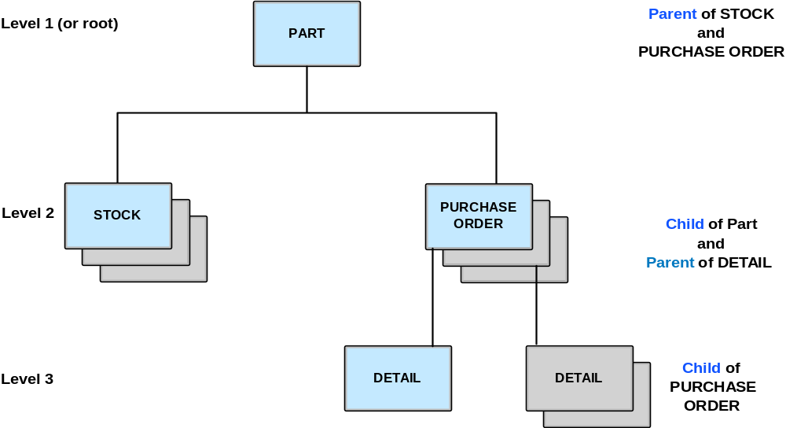
Hierarchical data structure (IMS)

Slide 8
DB2 – The Relational Database
Relational Structures include:
Database:
  A logical grouping of data for one or more applications
Table:
  A logical structure composed of rows and columns
Index(es):
  An ordered set of pointers to rows of a table (ensures uniqueness)
Keys:
  One or more columns that are identified as such in the creation of a table or used for referential integrity

Slide 9
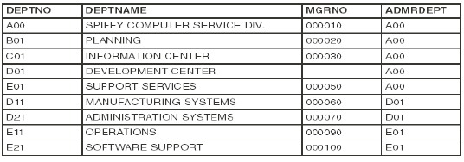
Example of a DB2 Department Table i.e. “owner.DEPT”
At the intersection of every column and row is a
specific data item called a value or more precisely
an atomic value

Slide 10
Relational DBMS: data structures and SQL
Databases
  Tables : column, row and value
  Indexes
  Keys
    Primary Key – only one because it defines the entity (e.g. Lastname,Firstname)
    Unique Key – another key also used for access (e.g. SIN)
    Foreign Key – used for referential integrity between keys of different tables
SQL: High level language used to interrogate and process data in a relational database
  DML (Data Manipulation Language): SELECT, UPDATE, INSERT, DELETE
  DDL(Data Definition Language): CREATE, ALTER, DROP
  DCL (Data Control Language) : GRANT, REVOKE

Slide 11
Managing DB2: System Administration (SYSADM)
Installation
System Object Management
System and Disaster Recovery
Monitoring System Performance
“Contains all privileges for the entire DB2 Subsystem”

Slide 12
Managing DB2: Database Administration (DBADM)
Creation & Management of DB2 Objects for a particular DB2 Database
Execution of Utilities:
  Data Organization
  Backup & recovery
  Data Consistency

Slide 13
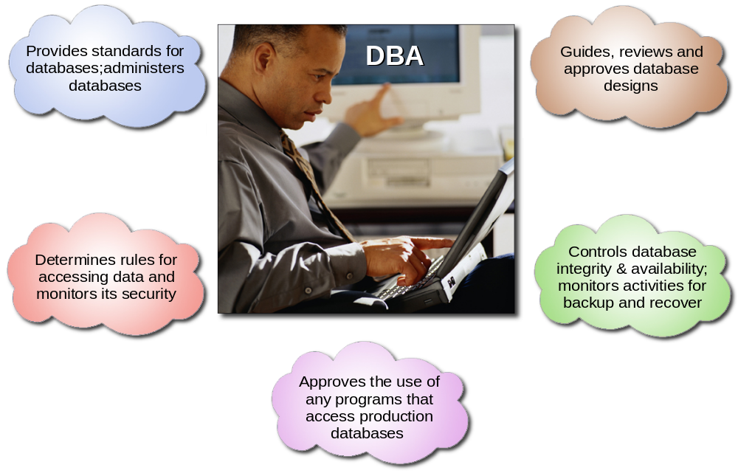
Role of the database administrator

Slide 14
DB2 Administration (transactional interfaces)
SQL Processor Using File Input (SPUFI)
  A SQL interface through TSO providing a means for a transactional facility used by DBAs. This requires knowledge of ISPF and basic PDS.
  Pronounced “Spoo Fee”
Query Management Facility (QMF)
  Is a tightly integrated, powerful, and reliable tool that performs query and reporting for DB2. It offers an easy-to-learn, interactive interface. Users with little or no data processing experience can easily retrieve, create, update, insert, or delete data that is stored in DB2.

Slide 15
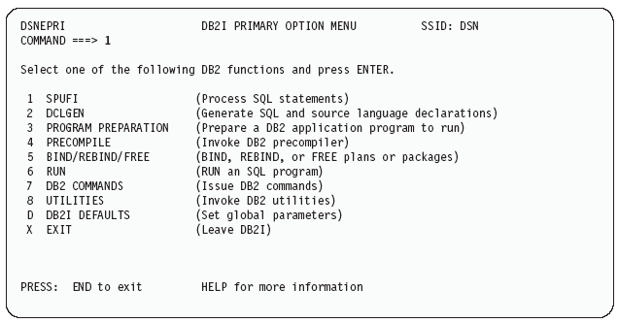
DB2I SPUFI Panel

Slide 16
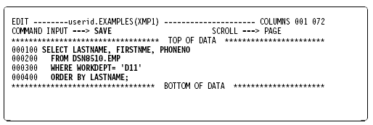
The SPUFI edit panel: After entering an SQL statement

Slide 17
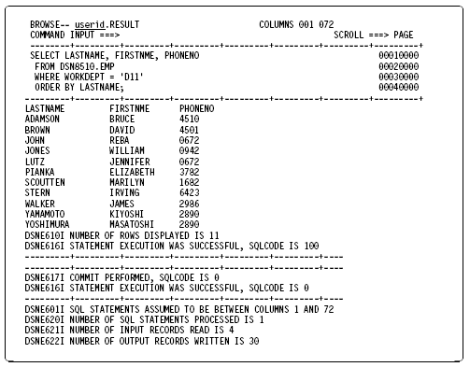
SPUFI Result Dataset from previous SQL

Slide 18
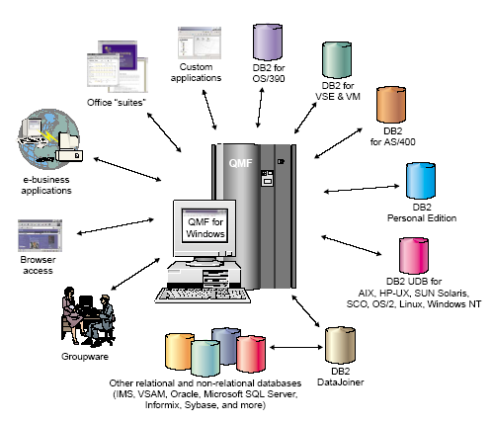
Query Management Facility

Slide 19
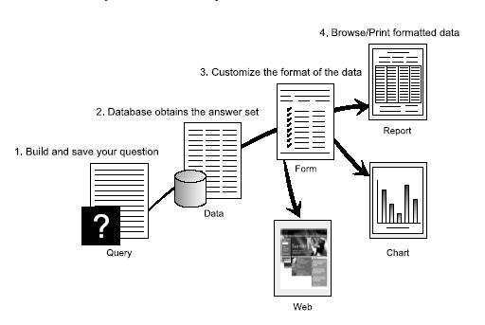
QMF provides results in 4 easy steps

Slide 20
Summary
Interaction with the computer happens online through the help of a transaction manager.
Many transaction managers and database managers exist, but their principles are similar.
Data can be stored in a flat file, but this can result in duplication or inconsistent data. It is better to create central databases, which can be accessed (reading and changing) from different places.
The handling of consistency, security, etc. is done by the database management system.

